Slide 1

Chapter 3: Pattern Discovery in Data Mining
Notes:
1

Slide 2
Pattern Evaluation
Objective
Importance of evaluating and measuring the quality of discovered patterns
Metrics and measures for pattern evaluation, such as support, confidence, and lift
Considerations for assessing pattern significance and usefulness
2

Slide 3
Pattern Evaluation
Importance of Pattern Evaluation
Pattern evaluation plays a critical role in determining the significance and value of discovered patterns.
It helps in identifying patterns that are relevant, interesting, and actionable.
3

Slide 4
Pattern Evaluation
Importance of Pattern Evaluation
Pattern-mining will generate a large set of patterns/rules
Not all the generated patterns/rules are interesting
Interestingness measures: Objective vs. subjective
Objective interestingness measures
Support, confidence, correlation, …
Subjective interestingness measures: One man’s trash could be another man’s treasure
Query-based: Relevant to a user’s particular request
- Against one’s knowledge-base: unexpected, freshness, timeliness
- Visualization tools: Multi-dimensional, interactive examination
4

Slide 5
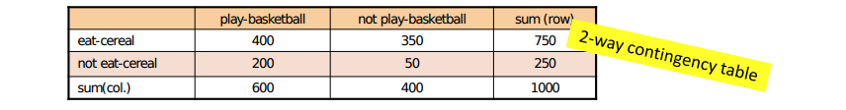
Pattern Evaluation
Limitations of Support and Confidence Framework
Support and confidence are commonly used measures for pattern evaluation.
However, they have limitations that can impact pattern assessment:
Lack of specificity: Support and confidence measures do not capture the uniqueness or distinctiveness of patterns.
Ignoring context: They do not consider the background knowledge or domain-specific context.
Example: Suppose one school may have the following statistics on # of students who may play basketball and/or eat cereal:
5

Slide 6
Pattern Evaluation
Interestingness Measures
Interestingness measures provide additional insights into the quality and interestingness of patterns.
Some interestingness measures that address the limitations of support and confidence include:
Lift: Measures the degree of association between items and evaluates the pattern's interestingness.
χ² (Chi-Square): Assesses the statistical significance and dependence between items in a pattern.
6

Slide 7
Pattern Evaluation
Lift Measure
Lift quantifies the strength of association between items and evaluates the pattern's interestingness.
Formula: Lift(A->B) = (support(A ∪ B) / (support(A) * support(B)))
Interpretation:
Lift > 1 indicates a positive association, suggesting a meaningful relationship between A and B.
Lift = 1 suggests independence, indicating that the items occur together by chance.
Lift < 1 implies a negative association, indicating that the items occur together less often than expected.
7

Slide 8
Pattern Evaluation
χ (Chi-Square) evaluates the statistical significance and dependence between items in a pattern.
Formula: χ² = N * (ad - bc)² / ((a + c) * (b + d) * (a + b) * (c + d))
a: Support of A and B
b: Support of B without A
c: Support of A without B
d: Remaining transactions
N: Total number of transactions
Interpretation:
Higher χ² values indicate stronger dependence between items.
Lower χ² values suggest weaker or independent relationships.
χ (Chi-Square) Measure
8

Slide 9
Pattern Evaluation
Advantages of Interestingness Measures
Capture Uniqueness: Interestingness measures consider the distinctiveness and significance of patterns beyond support and confidence.
Contextual Understanding: They incorporate domain-specific context and background knowledge, providing a better understanding of patterns.
Prioritization: Interestingness measures help prioritize patterns that are most informative and actionable.
9

Slide 10
Pattern Evaluation
Limitations and Considerations
Subjectivity(Tính chủ quan): Setting appropriate thresholds for interestingness measures can be subjective and dependent on the specific context.
Domain Expertise: Incorporating domain knowledge and expert judgment is crucial for meaningful pattern evaluation.
Complementary Measures: Considering multiple interestingness measures can provide a more comprehensive evaluation of pattern quality.
10

Slide 11
Pattern Evaluation
Null Invariance Measures
Null invariance measures evaluate the interestingness of patterns while considering the null hypothesis of independence.
These measures provide a comparison against the expected occurrence of patterns by chance.
11

Slide 12
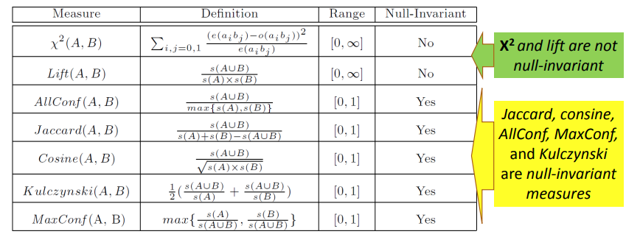
Pattern Evaluation
Interestingness Measures & Null-Invariance
12

Slide 13
Pattern Evaluation
Common Null Invariant Measures
Some widely used null invariant measures include:
Expected Confidence (EC): Measures the ratio of observed confidence to expected confidence under independence.
Jaccard Index: Calculates the intersection over the union of itemsets, considering both presence and absence of items.
Kulczynski Measure: Computes the average of the conditional probabilities of items in the pattern.
13

Slide 14
Pattern Evaluation
Expected Confidence (EC) Measure
EC measures the ratio of observed confidence to expected confidence under independence.
Formula: EC(A->B) = confidence(A->B) / support(B)
Interpretation:
EC > 1 indicates a positive association between A and B, exceeding what is expected under independence.
EC = 1 suggests no association or independence between A and B.
EC < 1 implies a negative association or an association weaker than expected under independence.
14

Slide 15
Pattern Evaluation
Jaccard Index
The Jaccard Index measures the similarity between two sets by calculating the intersection over the union.
Formula: J(A, B) = |A ∩ B| / |A ∪ B|
Interpretation:
Jaccard Index values closer to 1 indicate a higher similarity or association between A and B.
Values closer to 0 indicate dissimilarity or independence between A and B.
15

Slide 16
Pattern Evaluation
Kulczynski Measure
The Kulczynski Measure calculates the average of the conditional probabilities of items in the pattern.
Formula: Kulczynski(A->B) = (P(A|B) + P(B|A)) / 2
Interpretation:
Higher Kulczynski Measure values indicate a higher association or dependency between A and B.
Lower values suggest weaker or independent relationships.
16

Slide 17
Pattern Evaluation
Comparison of Null Invariant Measures
The choice of null invariant measure depends on the specific context and requirements.
Lift and χ² focus on association strength and statistical significance.
EC, Jaccard Index, and Kulczynski Measure provide different perspectives on the association and dependence between items.
It is recommended to consider multiple measures to gain a comprehensive evaluation of pattern interestingness.
17

Slide 18
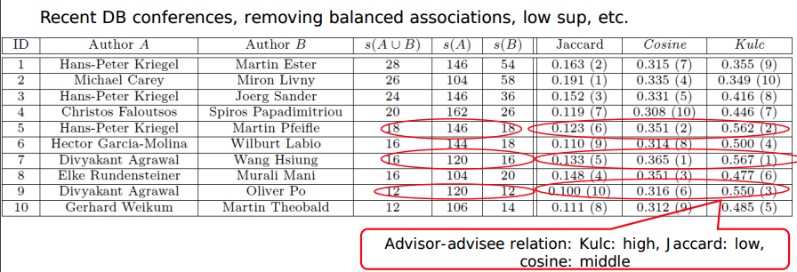
Pattern Evaluation
Example: Analysis of DBLP Coauthor Relationships
Which pairs of authors are strongly related? Use Kulc to find Advisor-advisee, close collaborators
18

Slide 19
Pattern Evaluation
Considerations for Pattern Evaluation
Contextual Relevance: Understand the domain context and relevance of patterns for effective evaluation.
Subjectivity: Pattern evaluation involves setting thresholds and interpreting measures, which can be subjective.
Iterative Process: Pattern evaluation is an iterative process that may involve refining thresholds, incorporating feedback, and adjusting measures.
19

Slide 20
Summary
Pattern Evaluation
Pattern evaluation: Assessing quality and significance.
Metrics: Support, confidence, lift, etc.
Significance: Distinguishing meaningful patterns.
Consideration: Measure selection and domain knowledge.
20

